Slide 1

Game Changer?
:D
By: Marci Morrell, Deautaun Ross, Eduardo Ortiz
:
:D
:D
:D
xd

Slide 2
What Is A Free Throw?
An unimpeded attempt at a basket (worth one point) awarded to a player following a foul or other infringement.
The amount of free throws will depend on the severity of the foul or infringement which ranges between 1 and 3
Notes:
To begin, what is a free throw? According to webster's dictionary a free throw is (read slide). Now because the player is allowed to gain points without infringement, these points seem advantageous in any basketball game. Sometimes its that one point that can change the direction of the game. And if you know anything about this guy (change slide)

Slide 3
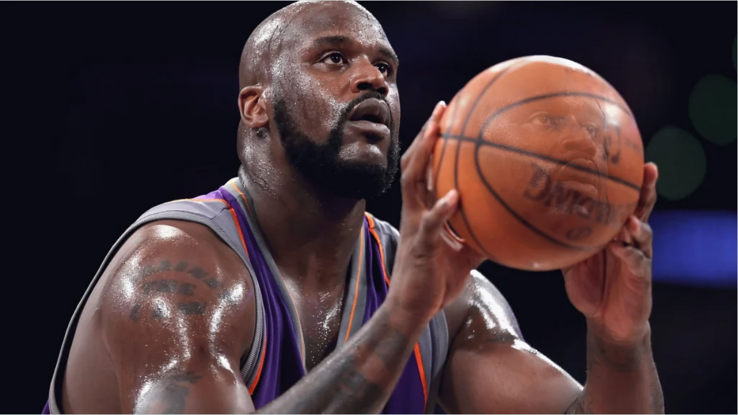
Notes:
You would understand how nervous fans would get while he stands on the free throw line. But if you don’t, this is Shaquille O'neal (or better known as Shaq) who despite being a great basketball player is notorious for being terrible free thrower. As a matter of fact, other teams would take advantage of this knowledge and purposely set up plays to utilize his terrible free throws. So our group wanted to see how truly advantages these free throws are.

Slide 4
Data
Original data set is from Kaggle and contains 618,019 rows
Includes player name, visit and home teams, shot count, whether the shot was made, etc.
Seasons from 2006-2015 (10 year span)
There were 12,869 unique games in the data set and 1,098 unique players

Slide 5
Questions
On average, what is the amount of free throws are taken and made?
What affects a player’s free throw rate? How much do free throws affect the game’s score?
How much does a player’s free throw rate vary over the years?

Slide 6
Overview
Each player in the data set took 6 free throws per game on average
Each player in the data set made 4.6 free throws per game on average
There was an average of 48 free throws attempted per game in the data set

Slide 7
Free Throw Contribution
In our dataset, all free throws attempted had the potential to contribute 24% to the overall score in the game
Free throw shots actually made in game made up 19% of the game’s overall final score
Notes:
Talk about how you got these numbers

Slide 8
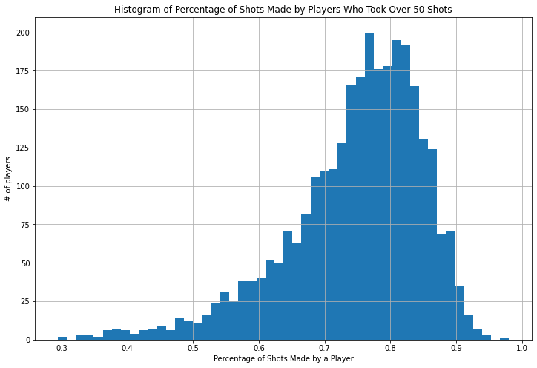
Percentage of Shots Made
Histogram shows percentage of shots made by players who took 50+ shots
Average % of shots made is 76%

Slide 9
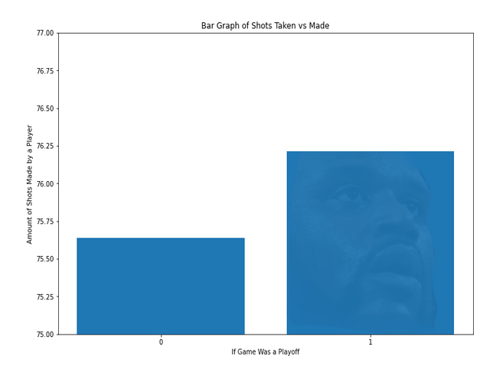
Do Playoff Games Affect Free Throws?
76.21% shots made during playoffs
75.64% made not playoffs
Less than 1% difference

Slide 10
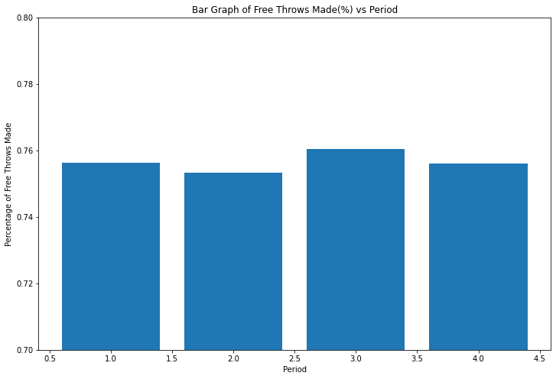

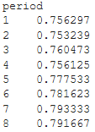
Period vs Free Throws Made (%)
Typical game has 4 periods
Excluded data from overtime periods
Most shots made in 3rd period, but less than 1% difference
shots_made pct_made

Slide 11
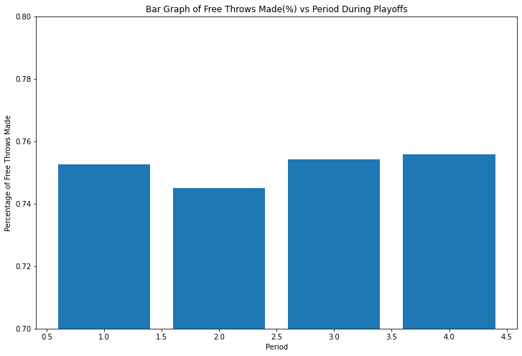
Playoff Game Periods

Slide 12
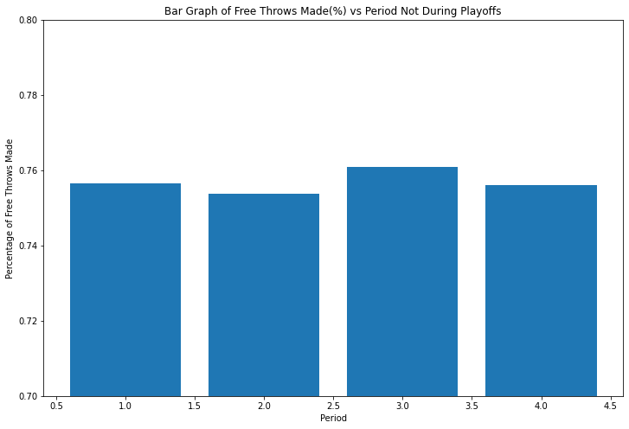
Non Playoff Game Periods

Slide 13
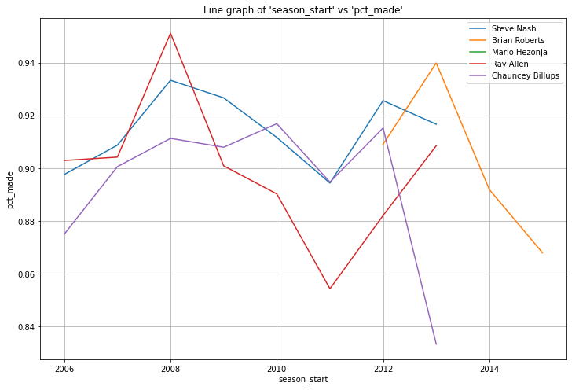
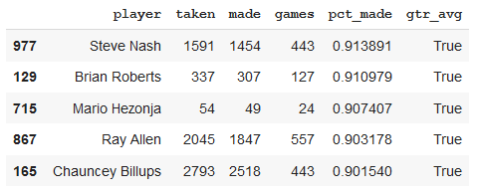
Top 5
Steve Nash is the most consistent of the top 5
Players free throw rate varies on average by 15%
Notes:
Because of the amount of players

Slide 14
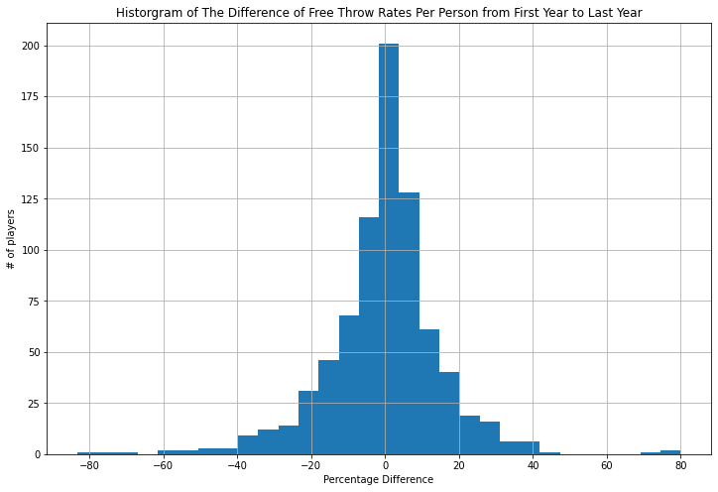
Free Throw Rate Difference by Time
We calculated the free throw rate of a player’s last year minus there first year
The rate changed on average by -0.4%

Slide 15
Overall Trends
Playoffs do not have a significant effect on free throws made
Minimal percent change of free throws made during each period
Free throw for each rate stays relatively constant

Slide 16
no.
At least not in this dataset.

